Slide 1

Indian Institute of Information Technology Una
SLR ( Sign Language Recognition )
By : Team Kalki
29-09-2023
IIITU-HP-India-Progothon
1

Slide 2
Outline
01
02
Introduction
Problem Statement
03
Objective and challenges
04
Workflow
05
06
Working of Prototype
Demo
07
08
Business Model
Future Work
29-09-2023
IIITU-HP-India-Progothon
2

Slide 3
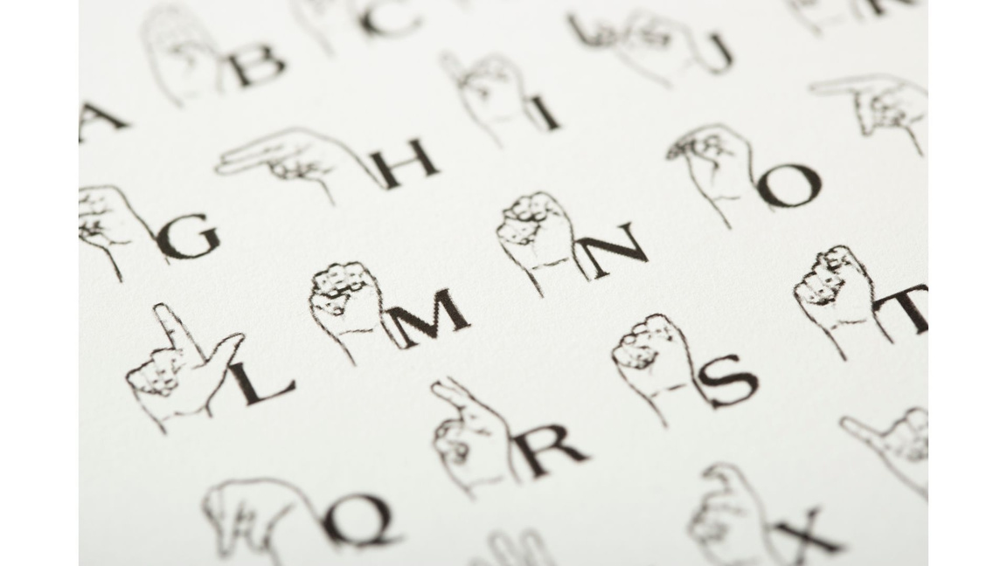
Introduction
For millions of deaf and mute individuals worldwide, it is not just a means of communication; it's their voice, expression, and connection to the world.
Recent technological advances have remarkable potential in bridging the communication gap between sign language users and the hearing world.
Sign languages are visual languages, relying on handshapes, movements, facial expressions to convey information.
29-09-2023
IIITU-HP-India-Progothon
3

Slide 4

Problem Statement
Difficulty in memorizing and using sign language.
Lack of a portable tool for recognising sign language.
Dependency on a human translator.
Existing solutions require heavy computational power.
Scalability Issues.
29-09-2023
IIITU-HP-India-Progothon
4

Slide 5
Objective and Challenges
Objectives
To design a system that recognises a hand gesture.
To carry out research for creation of a compact model.
Recognition from a live video feed.
Challenges
Environment adaptability.
Fast-Paced recognition.
29-09-2023
IIITU-HP-India-Progothon
5

Slide 6
Workflow
Creation of Dataset and Pre-processing
Model Selection/Architecture Definition
Model Creation and Training
Word to Sentence
Character to Word
Real Time Testing
29-09-2023
IIITU-HP-India-Progothon
6

Slide 7
Working of Prototype
Image Capturing From Camera
Hand Detection and Tracking
Critical points Segregation (21)
Pose Recognition using Spatial Distancing
Output in Text
29-09-2023
IIITU-HP-India-Progothon
7

Slide 8
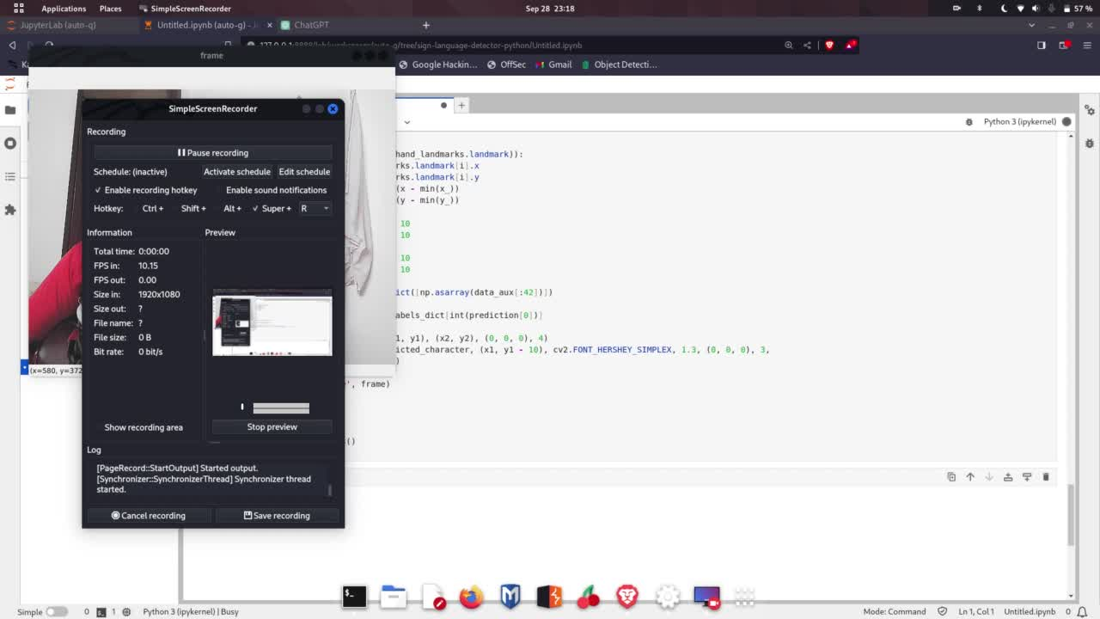
Demo
29-09-2023
IIITU-HP-India-Progothon
8

Slide 9
Business model
User Friendly and
Scalable
Target Market
Revenue Streams
Legal and Ethical Considerations
Easy Interaction
Compact size of model.
Deployment on EDGE Hardware
Deaf and Mute Peoples
Educational Institutions
Government PWD agencies
Software Licensing
Subscription based
Full product
Free Demo access for 1 month.
Complies with disability rights and regulations
29-09-2023
IIITU-HP-India-Progothon
9

Slide 10
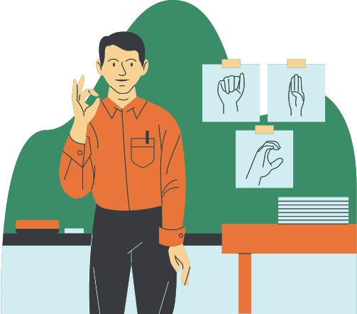
Future Work
Enhancing Models’ Accuracy at fast paced recognition
Integration with Video Calling Platforms
Integration with Indian Sign Language and Research Centre
29-09-2023
IIITU-HP-India-Progothon
10

Slide 11
Thanks!
Questions and Answers
Contact Details | Contact Details | Contact Details
Shubham | 21242@iiitu.ac.in | +91 8875964114
Prakhar Jaiswal | 21229@iiitu.ac.in | +91 7905728886
Dhruv Srivastava | 21215@iiitu.ac.in | +91 8840160729
29-09-2023
IIITU-HP-India-Progothon
11

